Slide 1
British Airways Task 2
Tsun Li Nicholas Tam

Slide 2
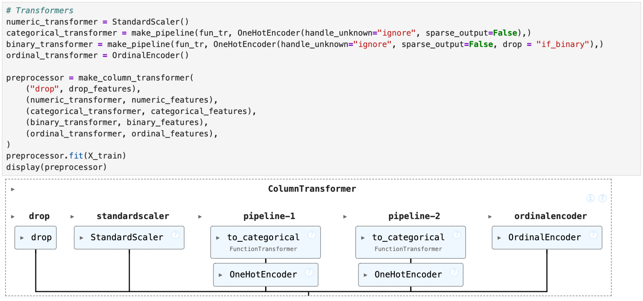
Preprocessing and transformations
Feature types:
Numeric: "num_passengers", "purchase_lead", "length_of_stay", "flight_duration"
Categorical: "sales_channel", "trip_type", "route", "booking_origin"
Binary: "wants_extra_baggage", "wants_preferred_seat", "wants_in_flight_meals"
Ordinal: "flight_hour", "flight_day"
All numeric columns have StandardScaler applied to them
All non-numeric columns have their data type converted to categories with FunctionTransformer, followed by one-hot encoding

Slide 3
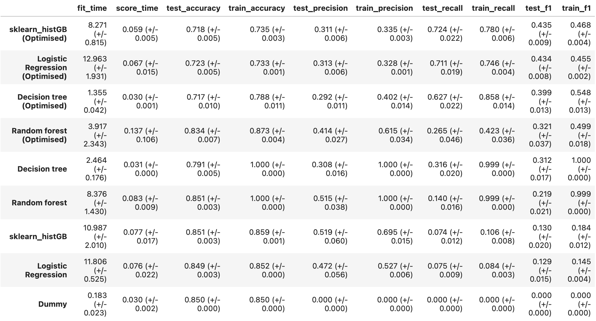
Training ML models
Models used:
Logistic regression
Decision tree
Random forest
Tree-based ensemble (HistGradientBoostingClassifier)
Models optimised with randomised search through RandomizedSearchCV
Models evaluated with mean and standard deviation of cross-validation scores, with test_f1 as metric of focus
Optimised logistic regression model and optimised tree-based ensemble model provided most effective results

Slide 4
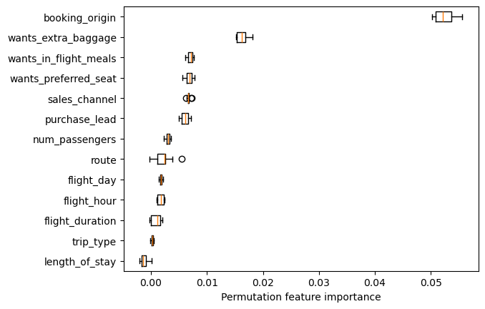
Optimised tree-based ensemble model results
Tree-based ensemble model can only provide permutation importance in place of feature importances
Booking_origin has greatest feature importance, followed by the various customer wants, with emphasis on extra baggage

Slide 5
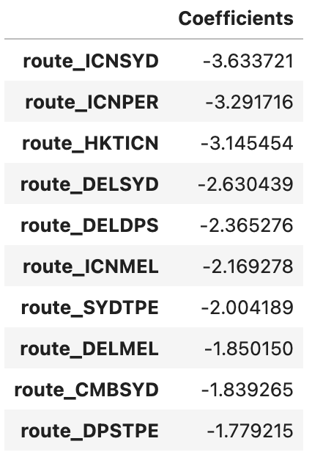
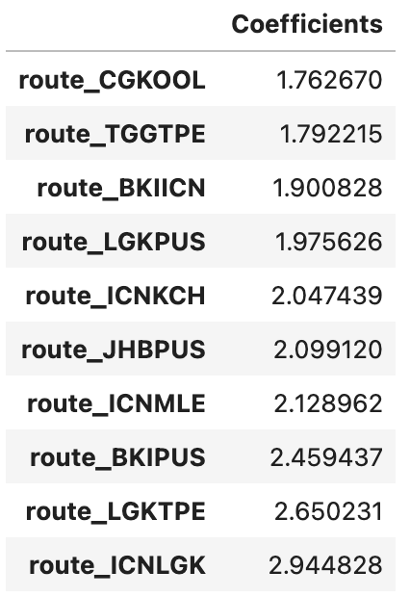
Optimised logistic regression model results
Various routes appear to provide consistently most extreme coefficients for predicting person’s customer buying behaviour
Questionable given that majority of variables created from transformations are from “route” feature

